Slide 1
CS 4530: Fundamentals of Software Engineering Lesson 9.3 Static Program Analysis
Jonathan Bell, Adeel Bhutta, Ferdinand Vesely, Mitch Wand
Khoury College of Computer Sciences
© 2022 Released under the CC BY-SA license

Slide 2
Learning Objectives for this Lesson
By the end of this lesson, you should be able to:
Explain what a static analyzer is, and give some examples.
List some of the things that a static analyzer could do
Explain some limitations of static analyzers in practice.

Slide 3
A Static Analyzer checks the program without running it
It inspects the program to detect certain patterns in the code.
These could be patterns or anti-patterns.
Could be bugs or style conventions
Examples:
The Typescript type checker
ESlint

Slide 4
The Type System is a Static Analyzer
The type checker reads the program and checks to see that every place where a function is called, the given arguments match what the function expects.
Benefits:
No pesky type errors at runtime
VSC runs the typechecker as you write, and provides explanations of the problems it finds.
Guaranteed 100% statement coverage, even in dead or rarely executed code.
Notes:
Javascript is an untyped language: you can apply any function to any argument. But if you give a function the wrong kind of argument, it may crash your program, or (worse) it may give some nonsense answer that will take you forever to debug. Having a tool that will prevent that is a huge advantage. (Read slide)

Slide 5
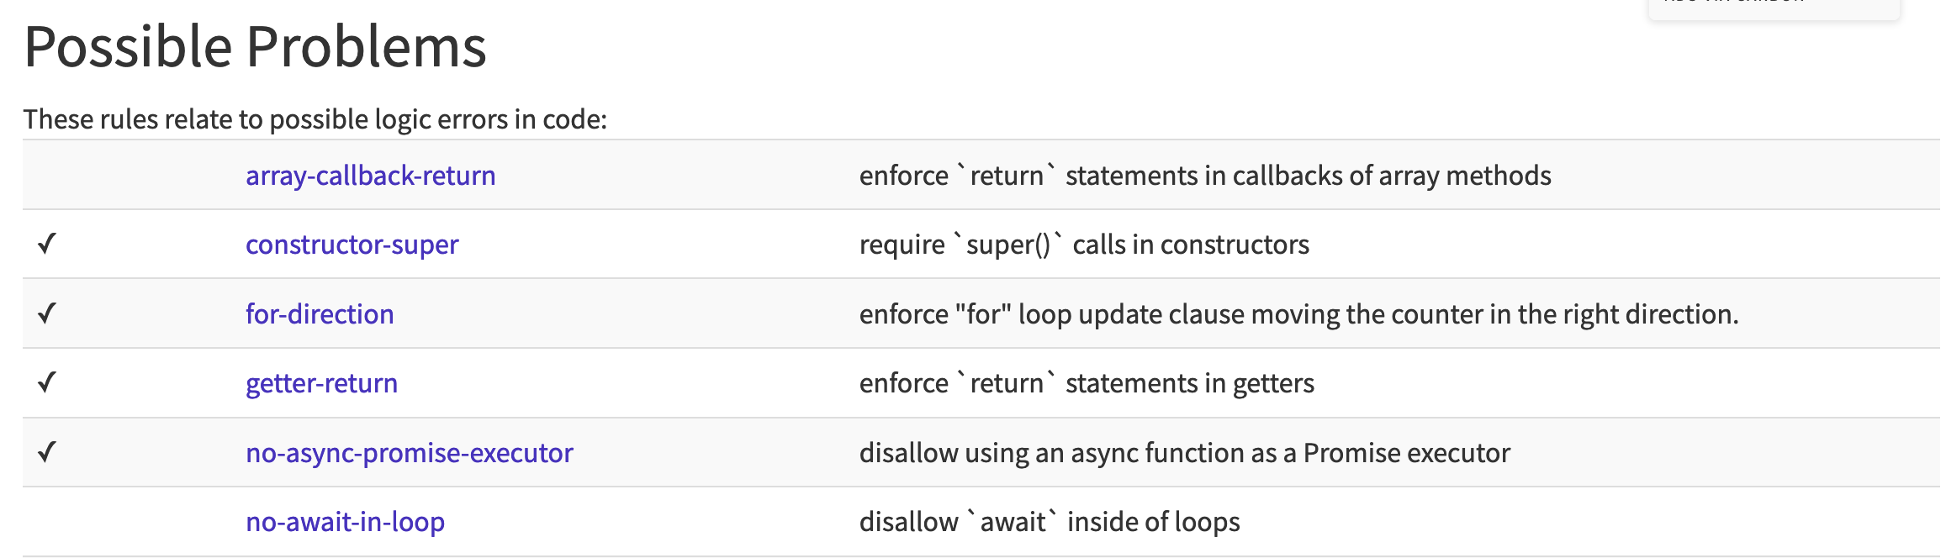
ESLint is your (favorite|least favorite) static analyzer
Linters = static analyzers for finding problematic patterns in code, stylistic errors, bugs
ESLint is a popular linter for JavaScript
Customizable via a set of rules
Notes:
Prof. Wand says: Before I had eslint in my workflow, I once spent 3 hours debugging a piece of code where I had written “=“ instead of “==“. ESLint would have found that for me right away.

Slide 6
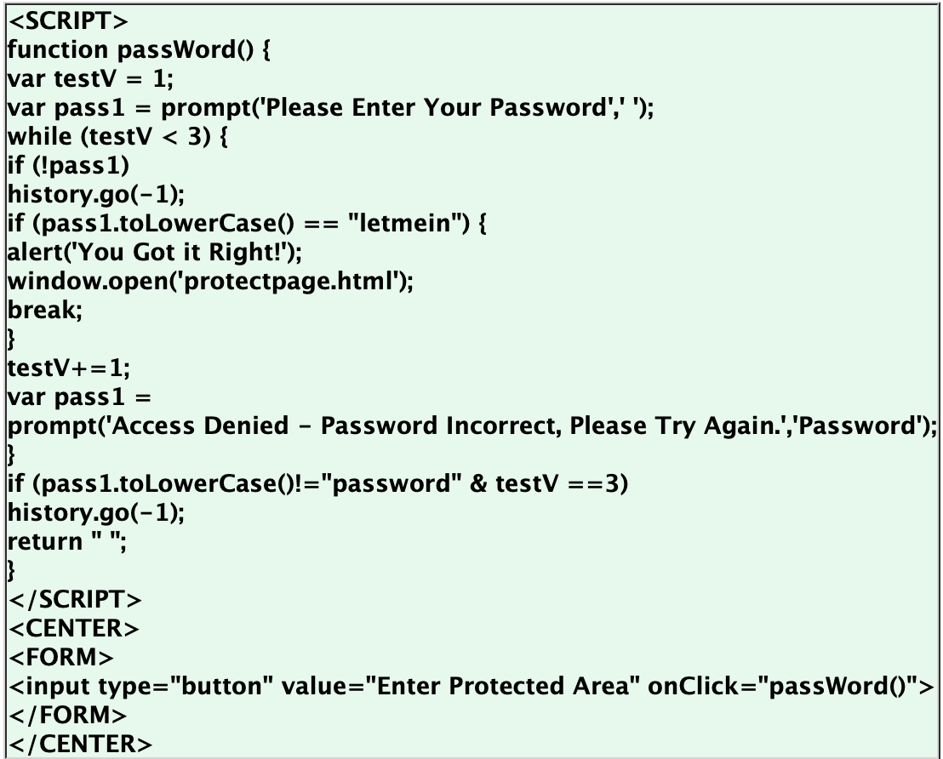
Static Analyses can detect some dangerous anti-patterns
CWE-798: Use of Hard-coded Credentials
Notes:
Here’s CWE-798. Notice the hard-coded credentials (click)

Slide 7
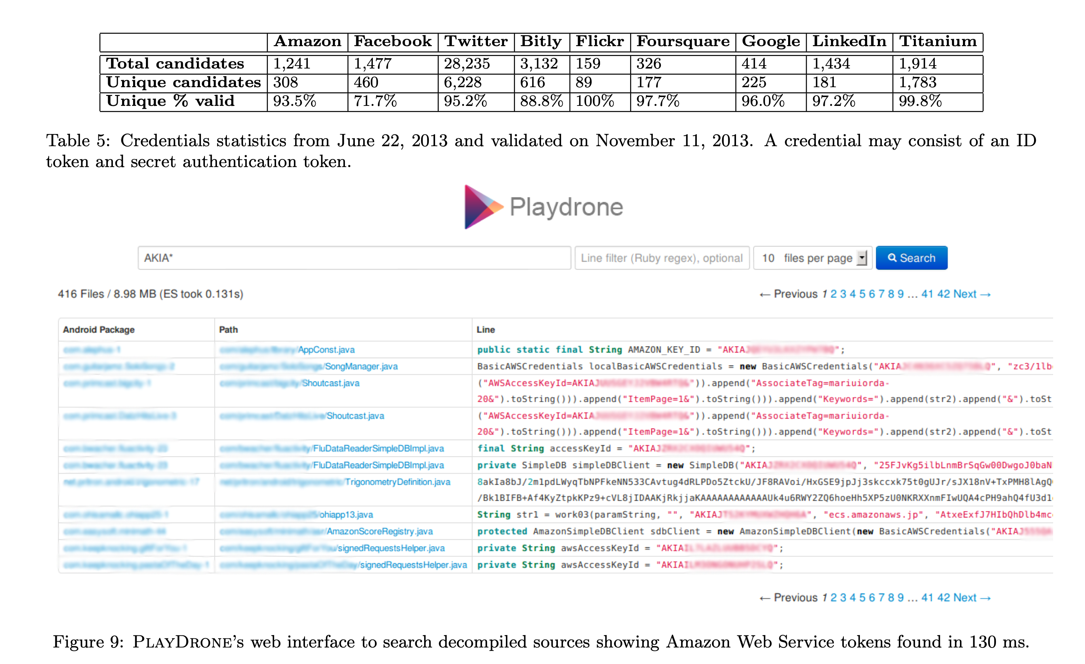
Static Analysis showed this kind of fault was widespread
CWE-798: Use of Hard-coded Credentials: Study of 1.1m Android Apps
“A Measurement Study of Google Play,” Viennot et al, SIGMETRICS ‘14
Notes:
Some folks did a study of Android apps on the Google Play store, and discovered that several thousand of them contained plain-text tokens for various services. The columns above show the different services for which the apps held tokens; the last row shows that most of them still worked, at least as of the date of the study (June, 2013).

Slide 8
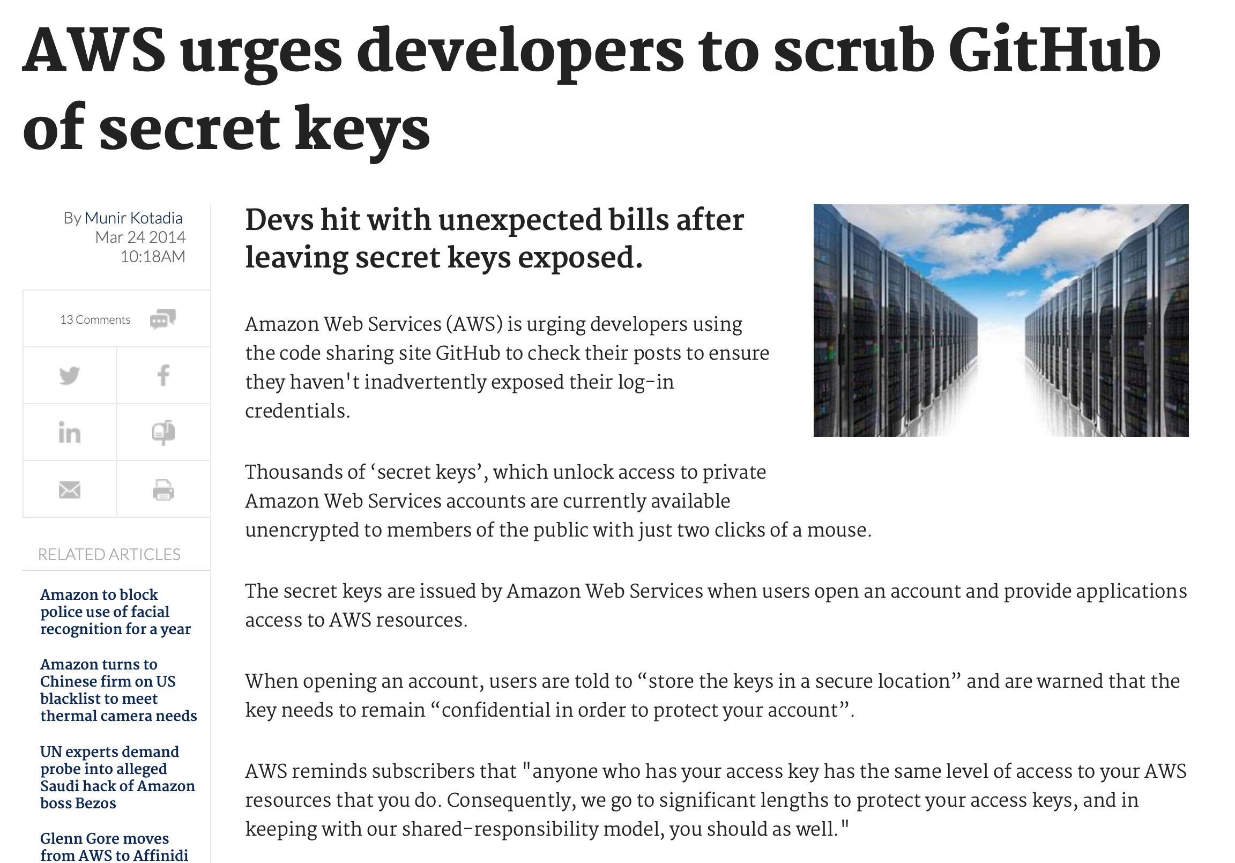
This discovery led to action.

Slide 9

That example wasn’t hard: the tool just looked for a certain regex.
GitGuardian (Launched in 2017)
Notes:
Here’s a more recent tool, called GitGuardian, that is tailored for looking for hard-coded secrets in github repos (read the sentence starting “scan your source code..”)

Slide 10
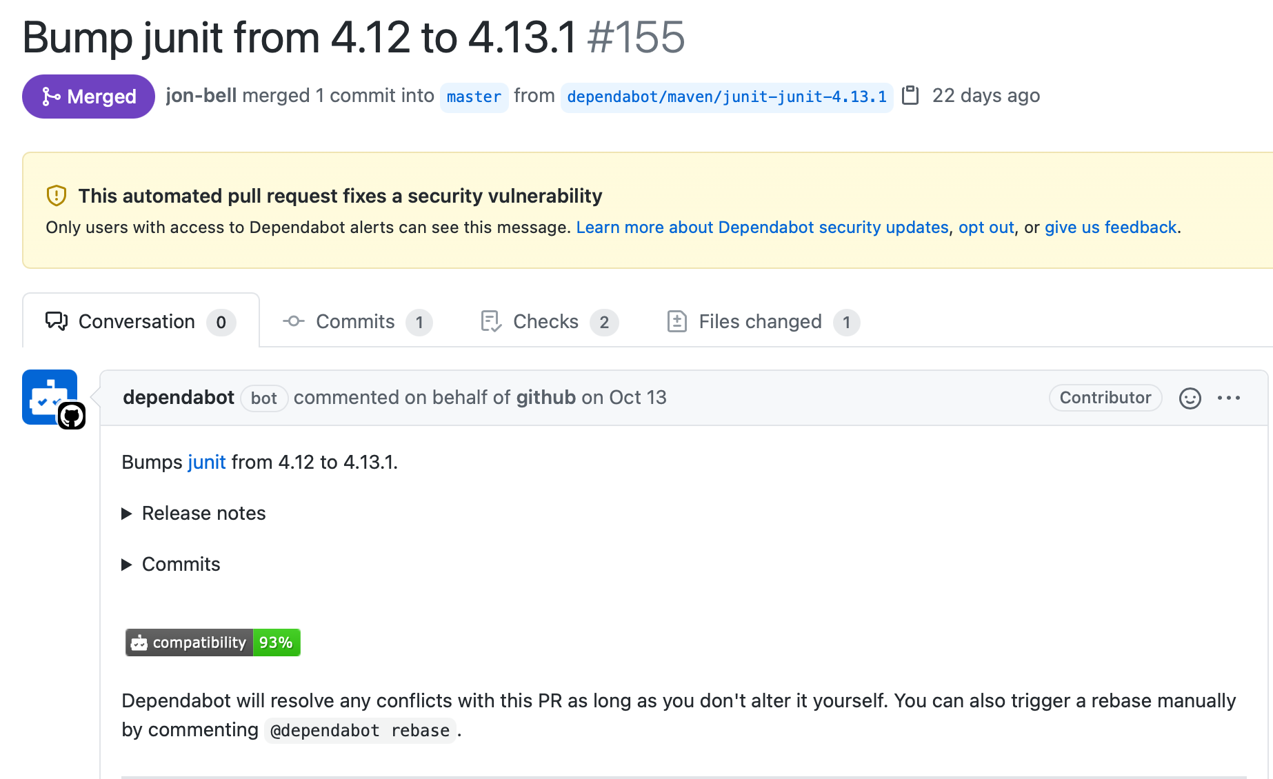
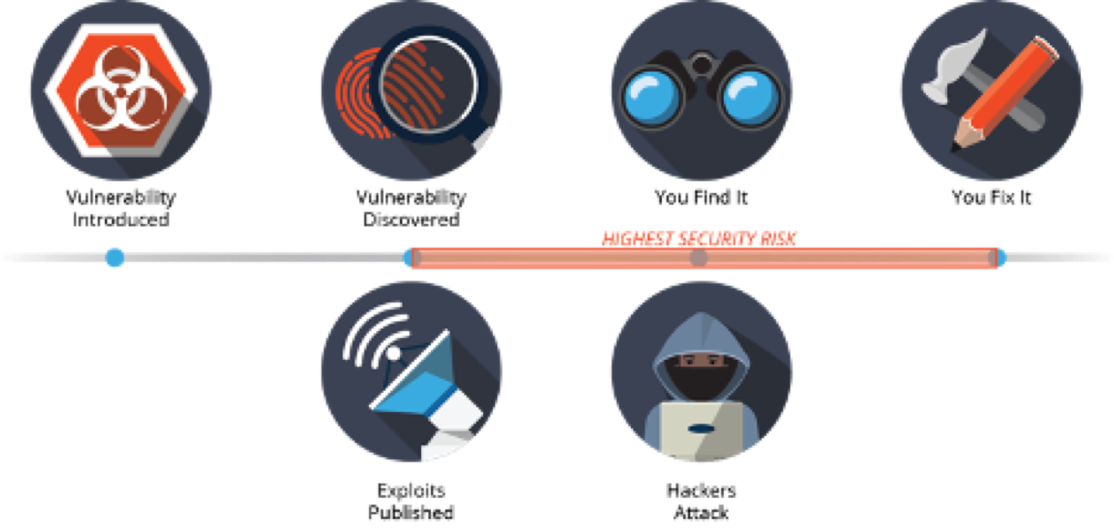
An example using GitGuardian.
A9:2017-Using Components with Known Vulnerabilities
Notes:
This one is also not that hard: just need to look at dependencies. And here it was built into the github action.

Slide 11
Defects Static Analysis can Catch
Defects that result from inconsistently following simple, mechanical design rules.
Security: Buffer overruns, improperly validated input.
Memory safety: Null dereference, uninitialized data.
Resource leaks: Memory, OS resources.
API Protocols: Device drivers; real time libraries; GUI frameworks.
Exceptions: Arithmetic/library/user-defined
Encapsulation: Accessing internal data, calling private functions.
Data races: Two threads access the same data without synchronization
Key: check compliance to simple, mechanical design rules
Notes:
Static analysis can catch interesting errors that testing won’t. This is especially important for safety-critical systems. Microsoft got a huge win when it introduced static analysis of all its device drivers, effectively eliminating the “Blue Screen of Death” (click)

Slide 12
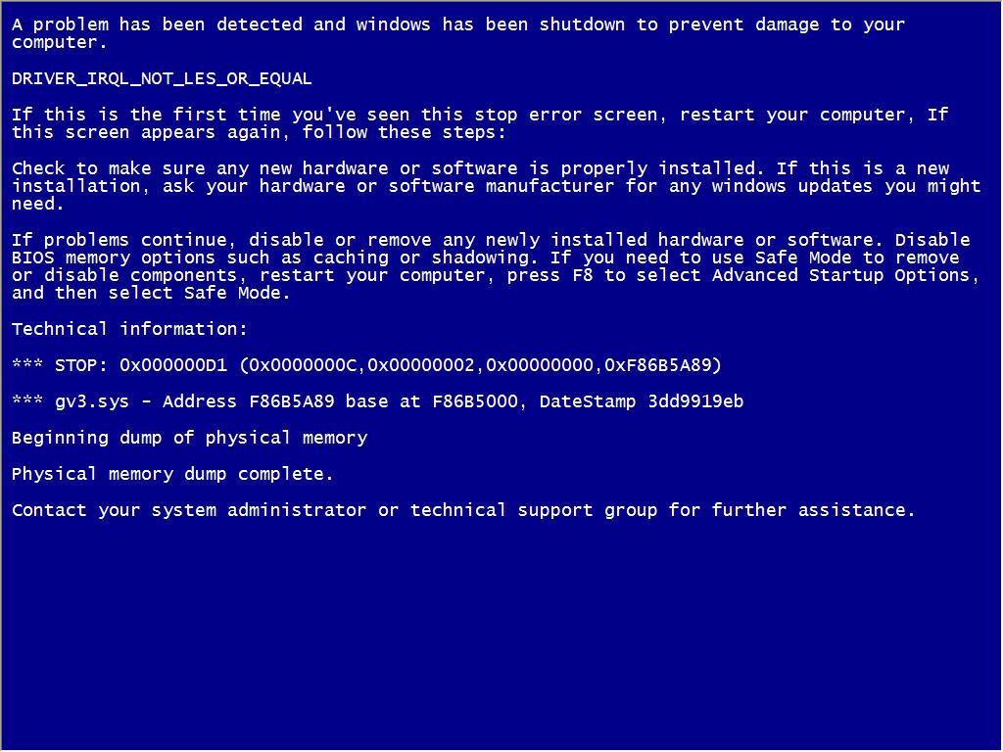
Notes:
How many of you are old enough to remember screens like this?

Slide 13
Static Analysis isn’t perfect
Example: “every opened file is eventually closed”
An analysis could miss some closes of opened files
Or it could miss some open file not getting closed.

Slide 14
Getting precise results may require compromise
Getting precise results may take time:
Some algorithms take exponential time.
Practical algorithms are limited to linear time
Getting precise results may require whole program:
If parts of the program loaded at runtime:
Analysis results may be very imprecise, or (worse)
Incorrect, if they assume the whole program is available.
Getting precise results may require intervention:
Code may need to be annotated with information:
E.g., “this method may return an open resource.”
E.g., type annotations

Slide 15
What happens when an analysis is imprecise?
FALSE NEGATIVES
FALSE POSITIVES
The static analysis misses something ”bad” in program:
Can give a false sense of security.
Can be reduced, but at the cost of false positives!
The static analysis reports a problem that doesn’t exist:
Real bugs can be swamped by a flood of spurious reports.
Programmer time is wasted chasing down false leads.

Slide 16
Bug Detection
Report
False Positive
True Positive
True Negative
False Negative
We generate a
false alarm.
We correctly
detect a bug.
Bug is absent
Bug is present
We correctly
find no problem.
We miss a bug
in the system.
No Report
Notes:
Here’s a nice picture of the possibilities. (Click through each of the 4 possibilities)

Slide 17
The fate of a bug report depends on more than whether or not it is accurate
A report from static analysis is effectively false,
If it is ignored by developers;
Whether or not it represents a true bug.
Even if the report is technically correct
It may refer to something considered unimportant:
E.g., who cares if all the files aren’t closed, if the program is about to exit anyway.
E.g., yes, there is a race condition between two logging statements, but that’s not important.
Even if the report is technically wrong
Developers may see potential problem, and fix.

Slide 18
Criteria For Good Automated Program Analysis
Efficient and Easy
Should not require whole program or annotations.
Should be automatically applied as part of workflow
Rarely spurious
No more than 10% effectively false positive.
Actionable
Should point out things easy to fix.
Effective
Problems should be perceived as important.
Source: Software Engineering at Google, Chapter 20

Slide 19
Could static analyses replace testing?
Short answer: no, not anytime soon.
There are ways for mathematically proving that a program satisfies its specification
But:
You need a specification
Existing proof techniques don’t scale
And your proof is no better than your specification
Go take a course in Formal Methods
Khoury has a whole research group on this

Slide 20
Review: Learning Objectives for this Lesson
You should now be able to:
Explain what a static analyzer is, and give some examples.
List some of the things that a static analyzer could do
Explain some limitations of static analyzers in practice.

